Slide 1
Lesson 7 - Sensors

Slide 2
Sensors
Sensors measure the environment and provide an output.
The sensors either output an analog or digital signal, and some can provide both.
The analog sensors can use the exact same code as the slider. We will use the raw data that we get from the sensors except for the temperature and distance sensors. We can convert the reading from the temperature sensor to a temperature in celsius and the reading from the ultrasonic sensor to a distance in cm.

Slide 3
Analog
Both
Digital
-Temperature
-Light
-Vibration
-Hall effect
-Sound
-Moisture
-Motion
-Distance

Slide 4
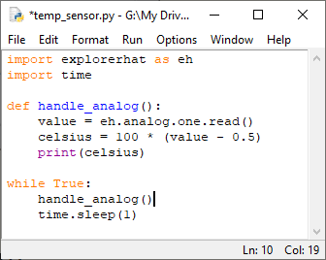
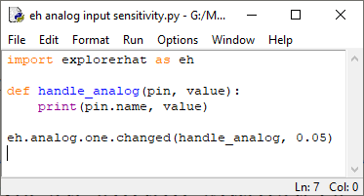
Analog Sensors Temperature Sensor
Adjust the sensitivity value until you get a reliable result.
This example is not using guizero or the changed method from the explorer hat module.

Slide 5
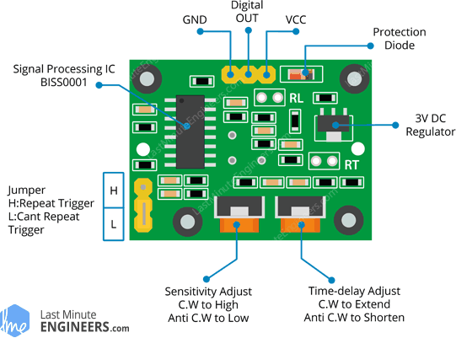
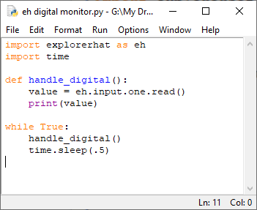
Digital Sensors - Motion Sensor
The motion sensor outputs either a 0 or a 1, just like a push button. There are two dials on the bottom of the circuit board, they are to adjust the sensitivity and the delay time.

Slide 6
There is a second type of motion sensor and light sensor, I don’t have enough for everyone to use but you can try it.
They are on the white circuit boards like the led bricks.
The motion sensor has a smaller dome like the on the motion sensor that is in your kits. It isn’t adjustable and only detects motion close to it but it works better. It uses the same code.
The light sensor looks like a flat led and there is a single resistor on the board with it.
They are both with the extra sensors in the cabinet in the shop

Slide 7
Analog and Digital Sensors
The sound and soil moisture sensors can output either an analog or digital signal depending on how you want it to be used. If you want to use it as an analog sensor then you connect the A0 pin to one of the analog inputs on the explorer hat. If you want to use it as a digital sensor then you connect the D0 pin to on of the regular input pins on the explorer hat.
They each have a potentiometer on them for tuning the digital output. You can adjust when the sensors will change from outputting a 0 or a 1.

Slide 8
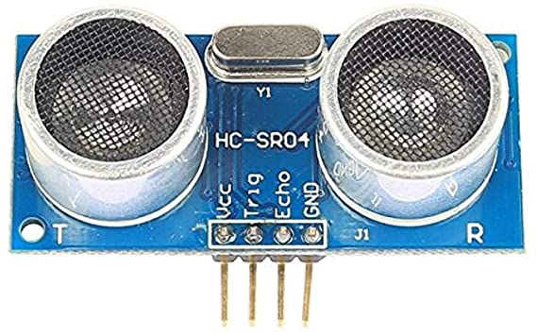
Digital Sensors - Ultrasonic Distance Sensor
The distance sensor works by sending out an ultrasonic sound wave and measuring the time it takes to return.
Be very careful if you decide to use this sensor. The 3.3V pins on the explorer hat are not protected like the 5V pins are. They are connected directly to the Pi. So shorting one of them to ground or 5V will likely damage your Pi.
Please check with your teacher if you decide to use this sensor.
The code is on the lasttwo slides, but I also have the python file the U4 Notes folder.

Slide 9
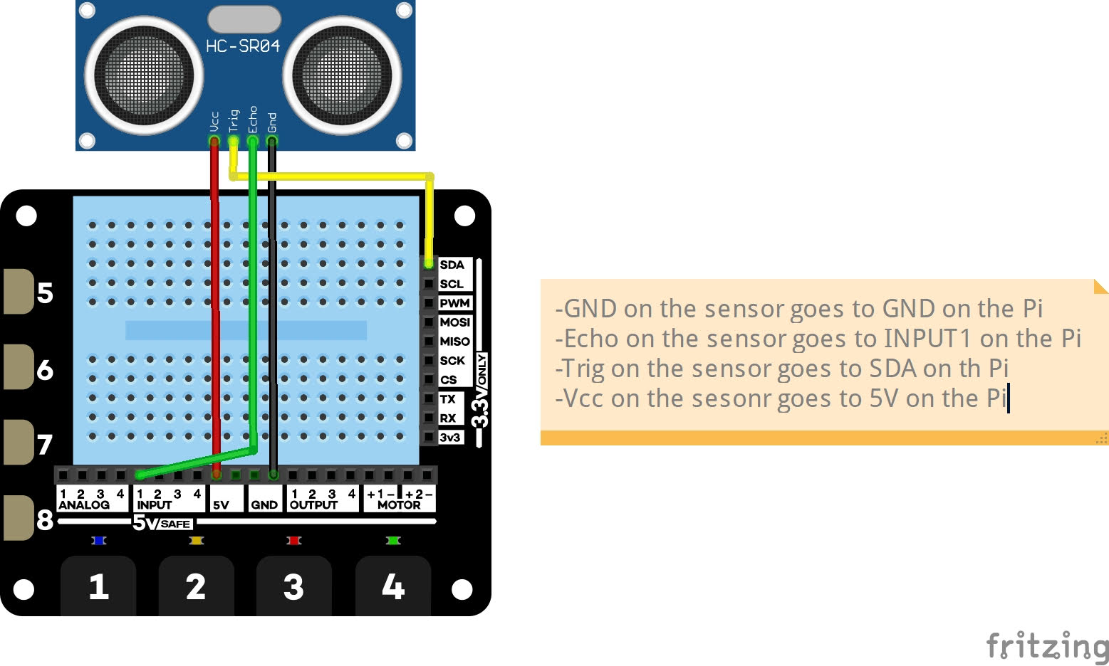

Slide 10
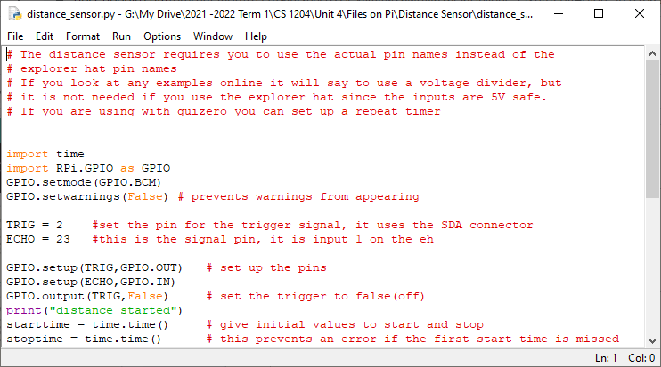

Slide 11
